Slide 1


NGINX AND CLOUD COMPUTING
Presented by : Keshribhan Suryavanshi

Slide 2



CONTENTS
1
Indroduction
2
Work
3
Application
4
Advantage
5
Disadvantage

Slide 3

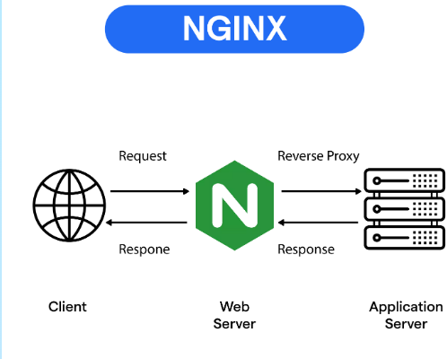
What is Nginx
Nginx (pronounced engine x) is open source Web server software that also performs reverse proxy, load balancing, email proxy and HTTP cache services. The software was originally created by Igor Sysoev as an answer to the challenge of handling 10,000 concurrent user connections: the C10k problem.
Work of nginx

Slide 4

What is Cloud ?
The term Cloud refers to a Network or Internet. In other words, we can say that Cloud is something, which is present at remote location. Cloud can provide services over public and private networks, i.e., WAN, LAN or VPN.
What is Cloud computing
Cloud Computing refers to manipulating, configuring, and accessing the hardware and software resources remotely. It offers online data storage, infrastructure, and application.
Cloud computing offers platform independency, as the software is not required to be installed locally on the PC. Hence, the Cloud Computing is making our business applications mobile and collaborative.

Slide 5

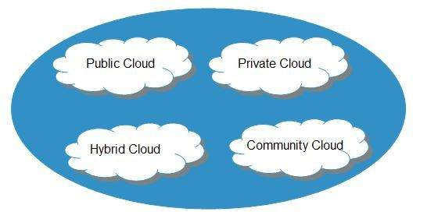
Basic Concepts
There are certain services and models working behind the scene making the cloud computing feasible and accessible to end users. Following are the working models for cloud computing:
Deployment Models
Service Models

Slide 6
THANK YOU

